Slide 1
Empowering and enabling the logistics industry globally.
Presentation title
Name of presenter
Position of presenter
DD Month YYYY

Slide 2
Design Patterns
Structural Design Patterns
Behavioral Design Patterns
Creational Design Patterns
Notes:
Design patterns are typical solutions to commonly occurring problems in software design.
When a solution gets repeated over and over in various projects, someone eventually puts a name to it and describes the solution in detail. That’s basically how a pattern gets discovered.
You can follow the pattern details and implement a solution that suits the realities of your own program.
Design patterns are divided into three main categories
The first category is Creational patterns, for which I made a presentation last year.
The second is Structural patterns. That's what I want to talk about today.
Structural patterns explain how to assemble objects and classes into larger structures, while keeping these structures flexible and efficient.
Creational patterns provide object creation mechanisms that increase flexibility and reuse of existing code.
Behavioral patterns take care of effective communication and the assignment of responsibilities between objects.

Slide 3
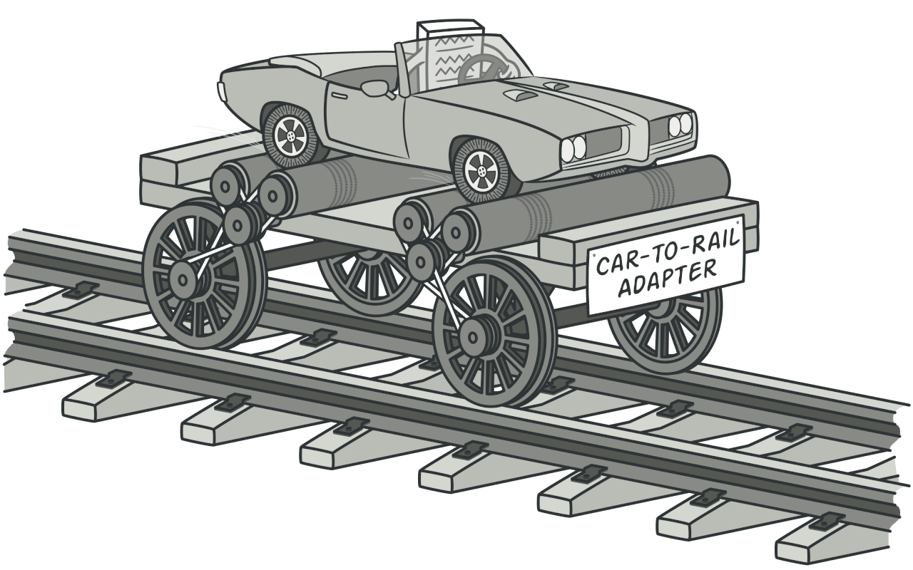
1. Adapter
Notes:
Imagine that there is a rail in front of you, but you only have a car. How can you get to your destination?
As you can see in the picture, we may need a “Car to Rail Adapter”.
The Adapter pattern allows objects with incompatible interfaces to collaborate.
So how can we implement it in actual code? Let's take a look at the example.

Slide 4
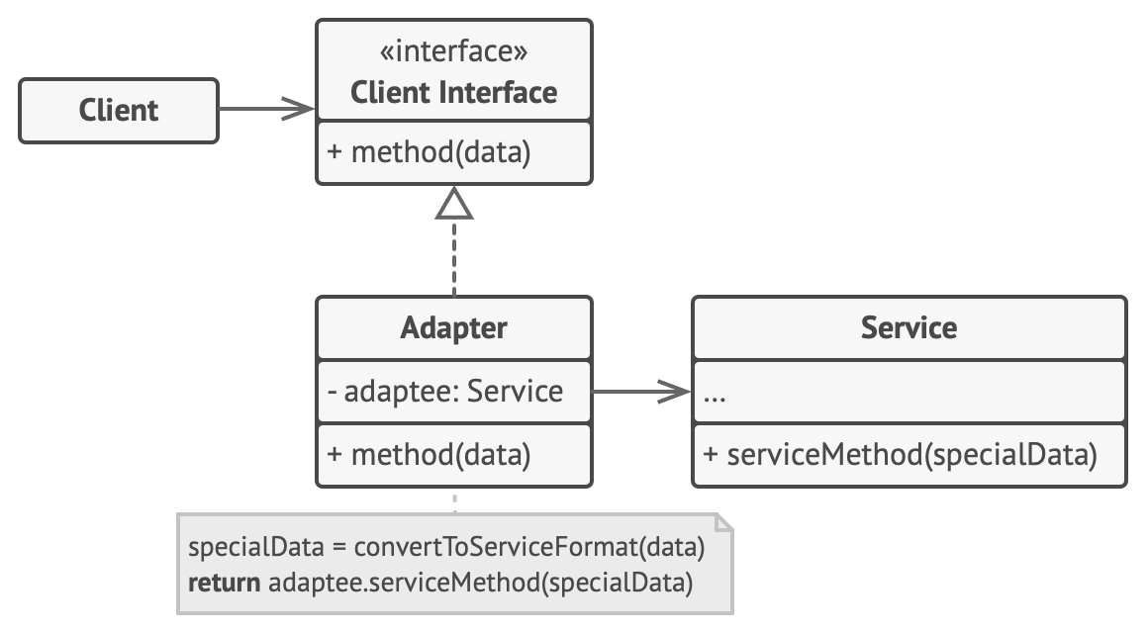
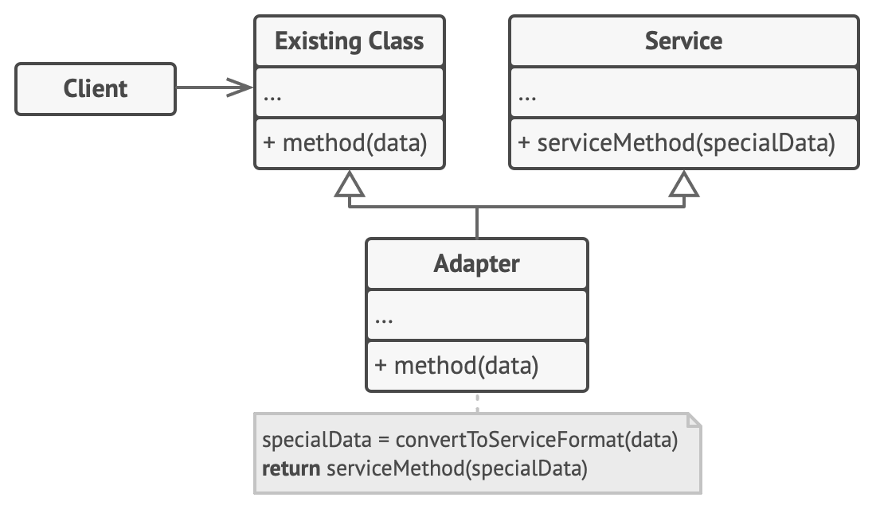
Target (Client Interface)
Adaptee (Service)
Adapter
Object Adapter
Class Adapter
Notes:
Depending on the implementation, it can also be divided into Object Adapter and Class Adapter.
The Client Interface describes a protocol that other classes must follow to be able to collaborate with the client code.
The Service is some useful class (usually 3rd-party or legacy). The client can’t use this class directly because it has an incompatible interface.
The Adapter is a class that’s able to work with both the client and the service: it implements the client interface, while wrapping the service object.
The adapter receives calls from the client via the adapter interface and translates them into calls to the wrapped service object in a format it can understand.

Slide 5
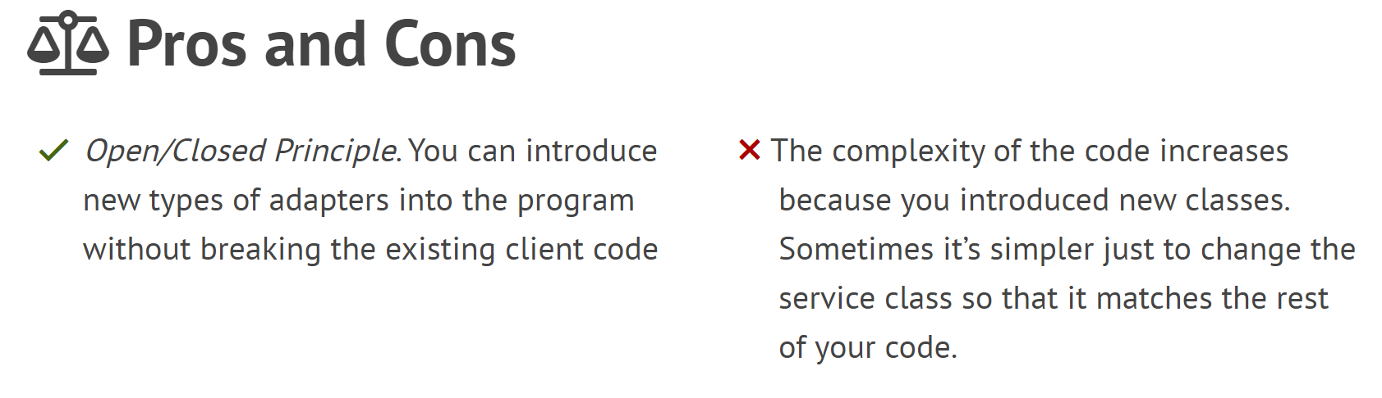
Notes:
In object-oriented programming, the open/closed principle states "software entities (classes, modules, functions, etc.) should be open for extension, but closed for modification";
That is, such an entity can allow its behavior to be extended without modifying its source code.
This is especially valuable in a production environment, where changes to source code may necessitate code reviews, unit tests, and other such procedures to qualify it for use in a product: code obeying the principle doesn't change when it is extended, and therefore needs no such effort.

Slide 6
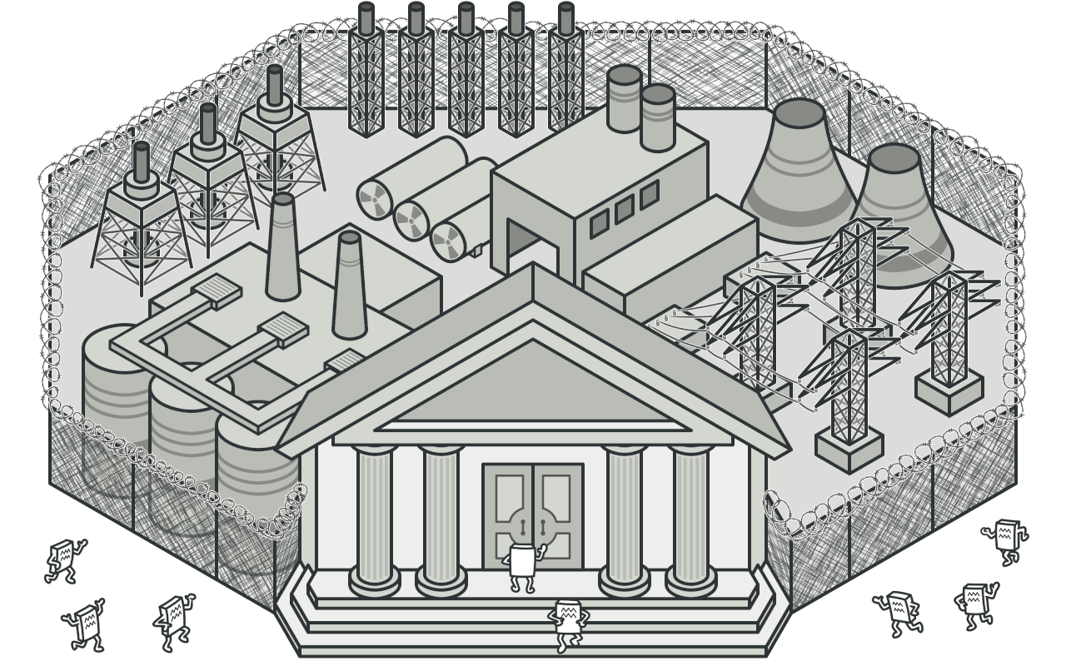
2. Facade
Notes:
Imagine that you must make your code work with a broad set of objects. Those objects belong to a complex library or framework.
Usually, you’d need to initialize all those objects, keep track of dependencies, execute methods in the correct order, and so on.
As a result, the business logic of your classes would become tightly coupled to the implementation details of 3rd-party classes, making it hard to maintain.
Facade provides a simplified interface to a library, a framework, or any other complex set of classes.

Slide 7
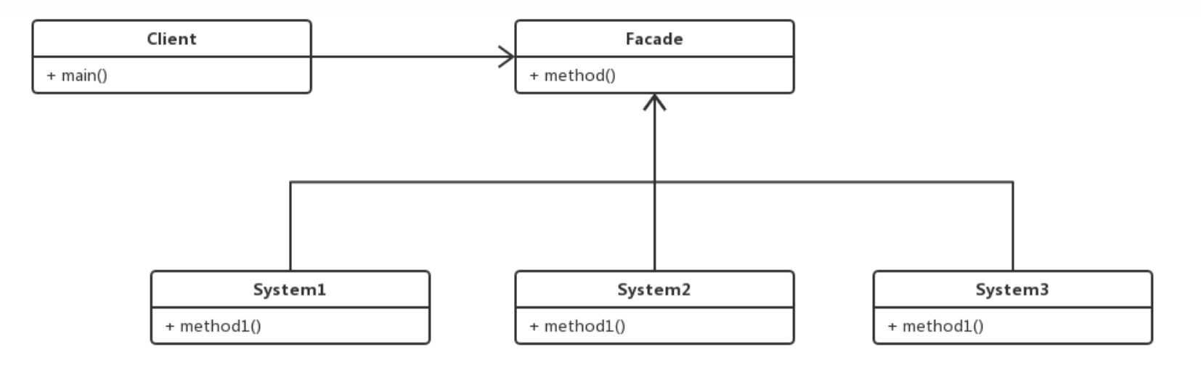
Facade
SubSystem
Notes:
The Facade provides convenient access to a particular part of the subsystem’s functionality. It knows where to direct the client’s request and how to operate all the moving parts.
The Complex Subsystem consists of dozens of various objects.
To make them all do something meaningful, you must dive deep into the subsystem’s implementation details, such as initializing objects in the correct order and supplying them with data in the proper format.
Subsystem classes aren’t aware of the facade’s existence. They operate within the system and work with each other directly.

Slide 8
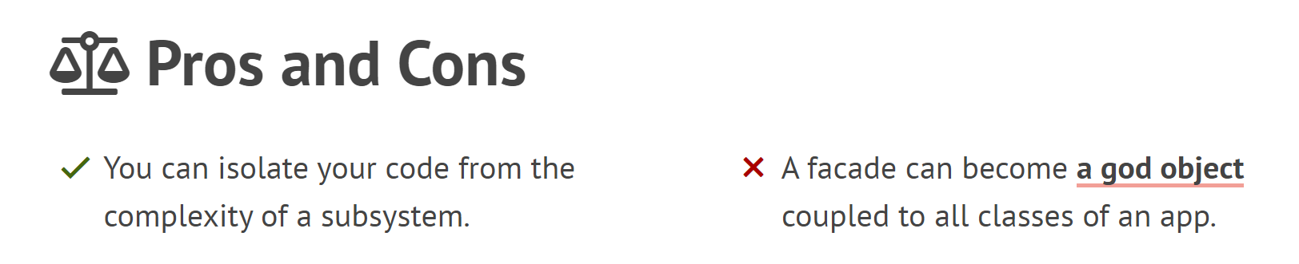
Notes:
Since the client code won’t get into complex logic of one or several subsystems.
However, the Facade delegates the requests to subsystem.
Subsystems often get more complex over time. The configuration it requires grows ever larger.
The Facade attempts to fix this problem by providing a shortcut to the most-used features of the subsystem which fit most client requirements.

Slide 9
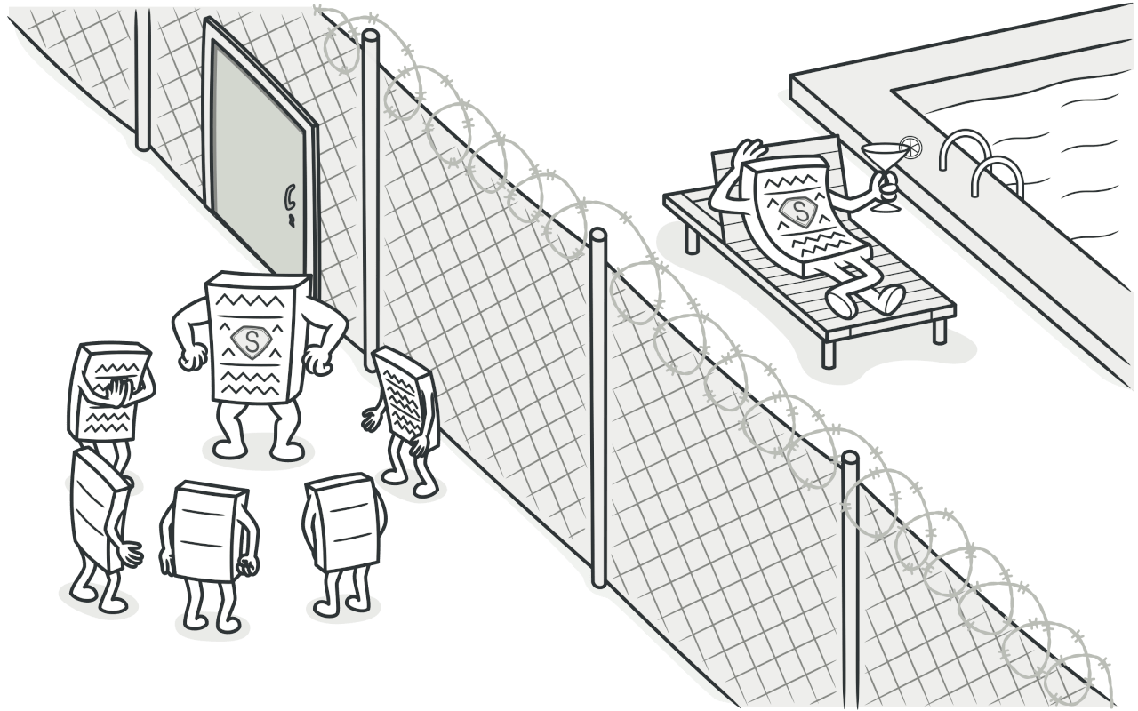
3. Proxy
Notes:
Proxy is a structural design pattern that lets you provide a substitute or placeholder for another object.
A proxy controls access to the original object, allowing you to perform something either before or after the request gets through to the original object.

Slide 10
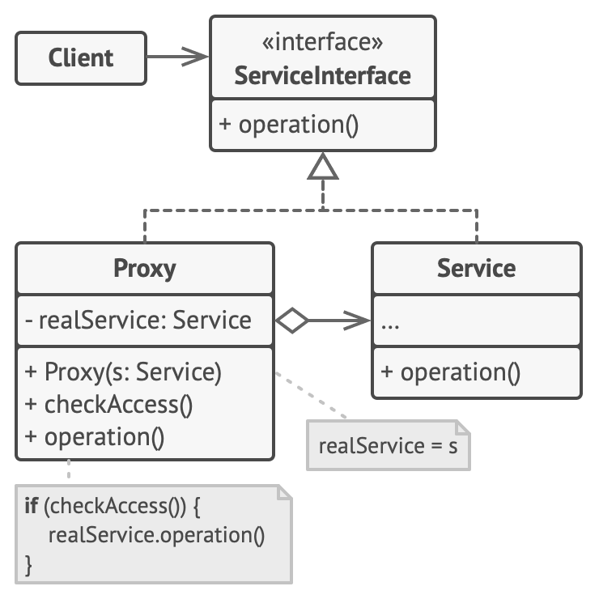
Subject
Real Subject
Proxy
Notes:
The Service Interface declares the interface of the Service. The proxy must follow this interface to be able to disguise itself as a service object.
The Service is a class that provides some useful business logic.
The Proxy class has a reference field that points to a service object.
After the proxy finishes its processing (e.g., lazy initialization, logging, access control, caching, etc.), it passes the request to the service object.
Usually, proxies manage the full lifecycle of their service objects.

Slide 11
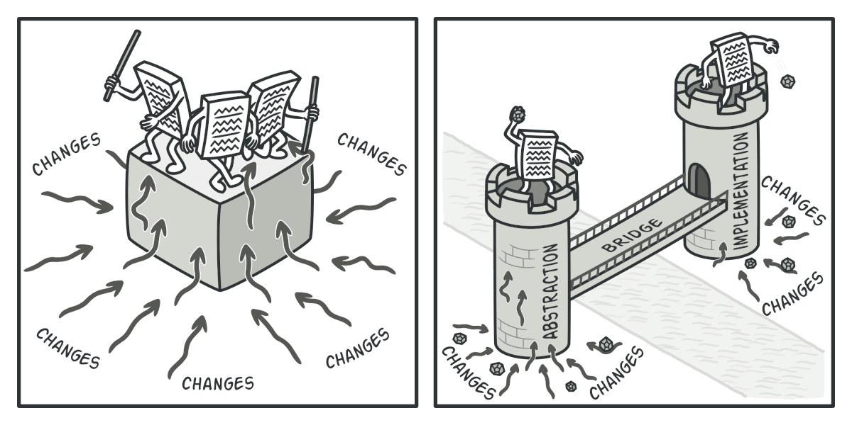
4. Bridge
Notes:
Bridge is a structural design pattern that lets you split a large class or a set of closely related classes into two separate hierarchies—abstraction and implementation—
which can be developed independently of each other.
Different implementations are interchangeable as long as they follow a common interface.

Slide 12
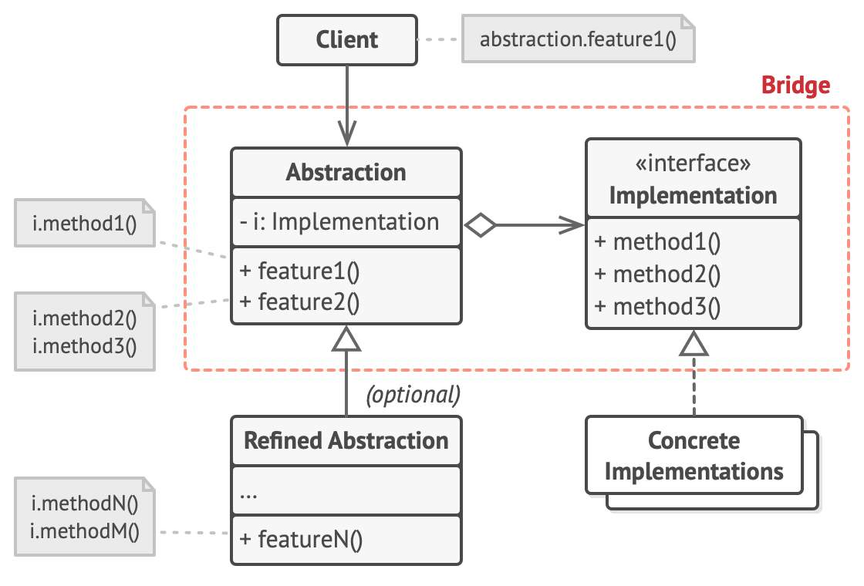
Abstraction
Refined Abstraction
Implementation
Concrete Implementations

Slide 13
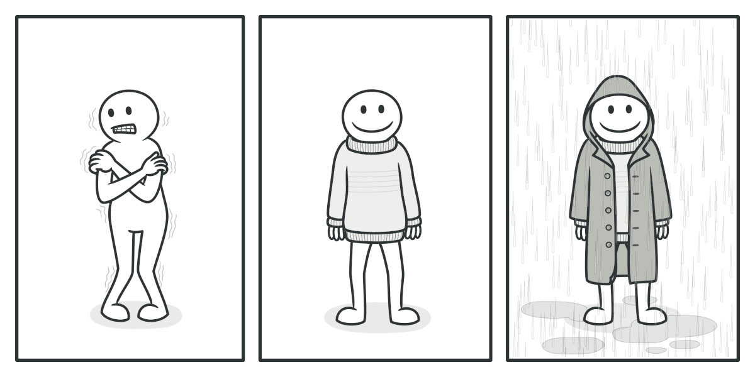
5. Decorator
Notes:
Decorator is a structural design pattern that lets you attach new behaviors to objects by placing these objects inside special wrapper objects that contain the behaviors.
Wearing clothes is an example of using decorators.
When you’re cold, you wrap yourself in a sweater.
If you’re still cold with a sweater, you can wear a jacket on top.
If it’s raining, you can put on a raincoat.
All these garments “extend” your basic behavior but aren’t part of you, and you can easily take off any piece of clothing whenever you don’t need it.

Slide 14
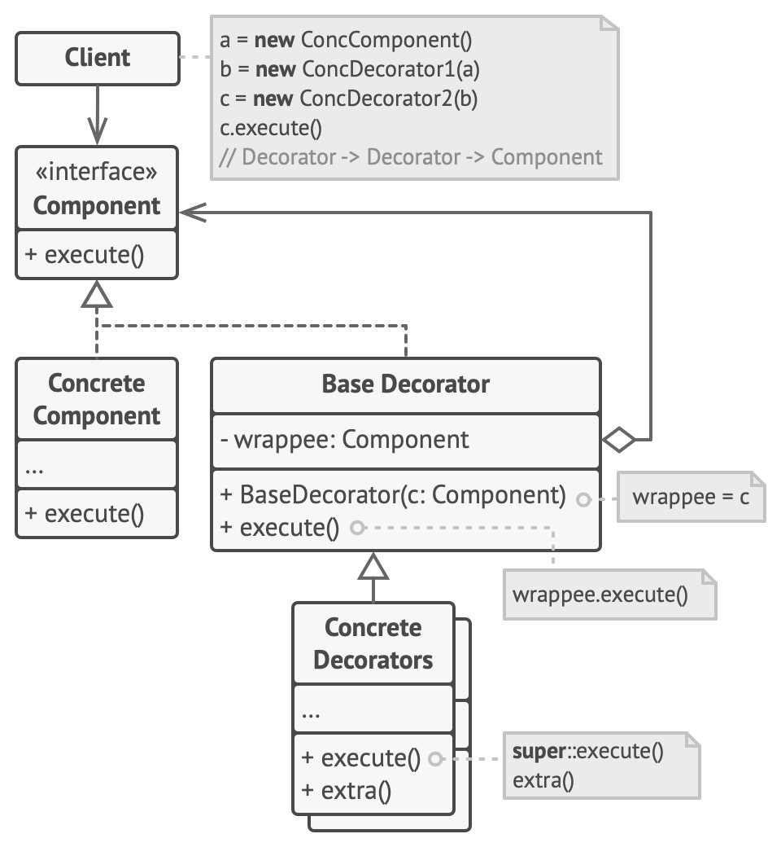
Component
ConcreteComponent
Base Decorator
ConcreteDecorator
Notes:
The Component declares the common interface for both wrappers and wrapped objects.
Concrete Component is a class of objects being wrapped. It defines the basic behavior, which can be altered by decorators.
The Base Decorator class has a field for referencing a wrapped object. The field’s type should be declared as the component interface so it can contain both concrete components and decorators.
The Base Decorator delegates all operations to the wrapped object.
Concrete Decorators define extra behaviors that can be added to components dynamically.
Concrete Decorators override methods of the base decorator and execute their behavior either before or after calling the parent method.

Slide 15
Structural Design Patterns
Adapter
Facade
Proxy
Bridge
Decorator

